Slide 1
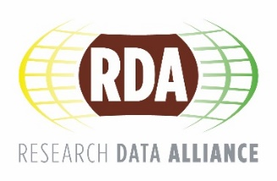
Research Data Alliance in a nutshell www.rd-alliance.org/about-rda
Fotis Karayannis,
ATHENA Research Center/RDA Secretariat
CC BY-SA 4.0

Slide 2
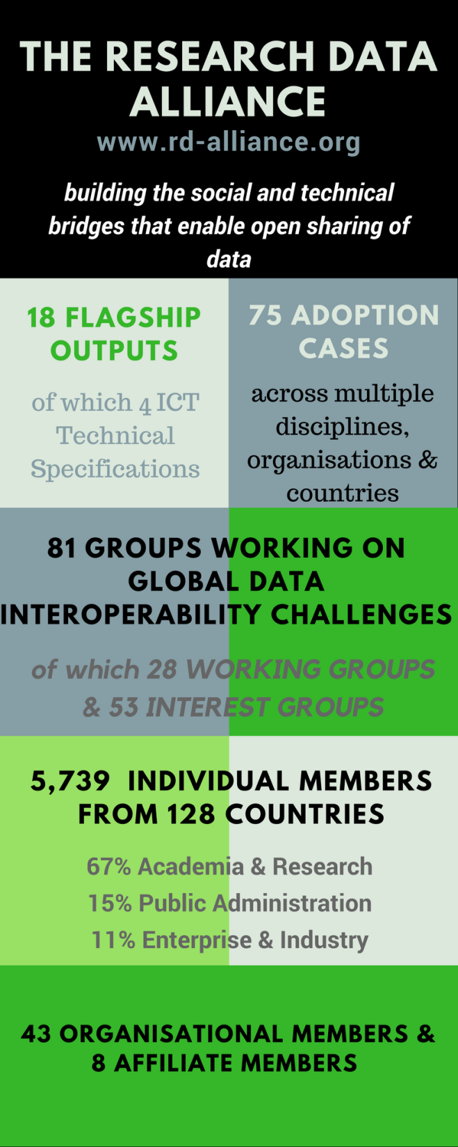
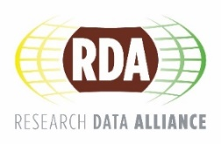
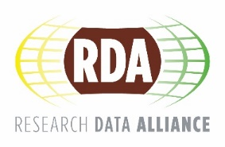
Vision
Researchers and innovators openly share data across technologies, disciplines, and countries to address the grand challenges of society
Mission
RDA builds the social and technical bridges that enable open sharing of data
CC BY-SA 4.0
Notes:
A snapshot of the RDA achievements…Grand challenges like resources, environment, climate

Slide 3
What is RDA?
RDA is an international member-based organisation focusing on the development of infrastructure and community activities that reduce barriers to data sharing and exchange, and the acceleration of data driven innovation worldwide With more than 5,700 members globally representing 128 countries, RDA includes researchers, scientists and data science professionals working in multiple disciplines, domains and thematic fields and from different types of organisations across the globe
RDA is building the social and technical bridges that enable open sharing of data to achieve its vision of researchers and innovators openly sharing data across technologies, disciplines, and countries to address the grand challenges of society
rd-alliance.org/about-rda
CC BY-SA 4.0

Slide 4
What does RDA do?
Members come together through self-formed, volunteer, focused Working Groups, exploratory Interest Groups to exchange knowledge, share discoveries, discuss barriers and potential solutions, explore and define policies and test as well as harmonise standards to enhance and facilitate global data sharing & re-use
RDA members collaborate together across the globe to tackle numerous infrastructure & data sharing challenges related to:
Data type registries
Data citation
Metadata
Best practices for domain repositories
Reproducibility
Data preservation
Legal interoperability
and so many more!
rd-alliance.org/about-rda
CC BY-SA 4.0
Notes:
RDA is a bottom-up organisation; Any members can come together and create Working or Interests Groups working on a volunteer basis. WGs are more focused and have to deliver outputs, while IGs are more exploratory. So, WG/IG members can exchange knowledge…

Slide 5
Who Can Join RDA?
Any individual or organisation, regardless of profession or discipline, with an interest in reducing the barriers to data sharing and re-use and who agrees to RDA’s guiding principles of:
Openness
Consensus
Balance
Harmonisation
Community-driven
Non-profit and technology-neutral
Individual Membership is free @ https://www.rd-alliance.org/user/register
rd-alliance.org/get-involved.html
CC BY-SA 4.0

Slide 6
Why Join RDA as an Individual Member?
Individual Member Benefits
Contribute to acceleration of data infrastructure development
Work and share experiences with collaborators throughout the world
Access to extraordinary human network with various levels of experience, perspectives and practices
Gain greater expertise in data science regardless of whether one is a student, early or seasoned career professional
Enhance the quality and effectiveness of personal work and activities
Improve one’s competitive advantage professionally and positioning oneself for leadership within the broader research community
Individual RDA Members 5739
rd-alliance.org/get-involved/individual-membership.html
CC BY-SA 4.0

Slide 7
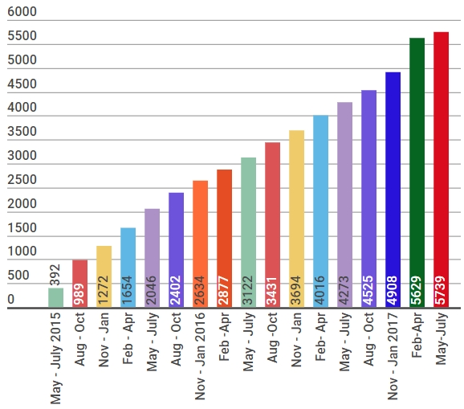
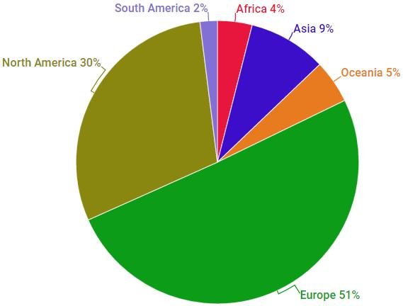
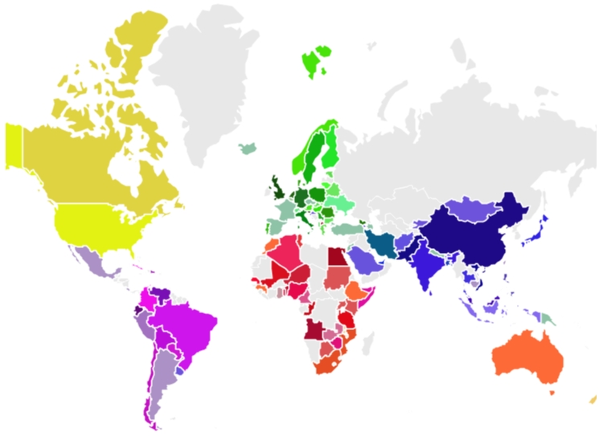
RDA worldwide growth
Total RDA community members 5739
126 Countries
128 Countries
rd-alliance.org/about-rda
CC BY-SA 4.0
Notes:
Some numbers…
First plenary: March 2013

Slide 8
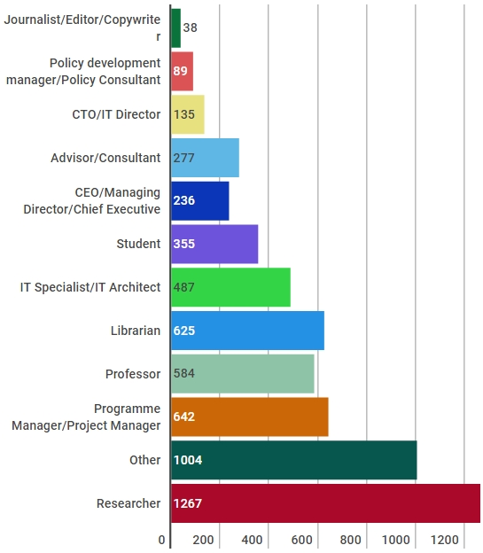
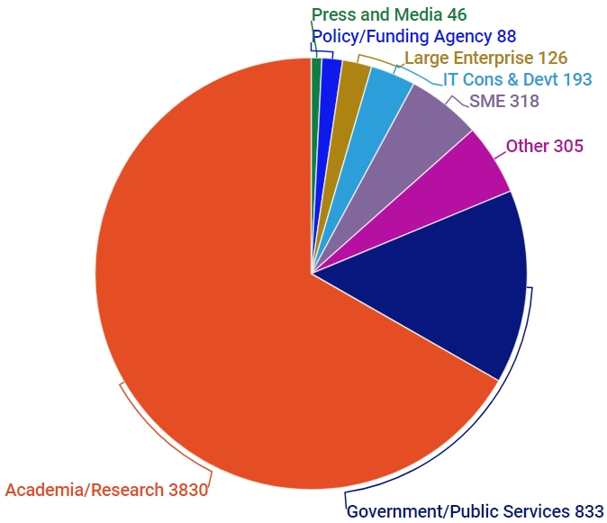
Who is RDA?
rd-alliance.org/about-rda
CC BY-SA 4.0
Notes:
Regarding the profiles…

Slide 9
Why Join RDA as an Organisational Member?
Organisational Member Benefits
Provide an organisational perspective on the work of RDA and ability to influence RDA’s direction
Assist in implementation & adoption of RDA Recommendations & Outputs
Receive regular updates on the work of the RDA
Participate in all RDA Organisational Assembly meetings and influence proposed policies
Vote for members of the Organisational Advisory Board
Provide advice to RDA Council through the Organisational Advisory Board
Be recognised on the RDA Website and at RDA Meetings
43 Organisational & 8 Affiliate Members
rd-alliance.org/get-involved/organisational-membership
CC BY-SA 4.0

Slide 10
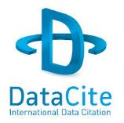
Organisational & Affiliate Members
43 Organisational Members
8 Affiliate Members
rd-alliance.org/get-involved/organisational-membership
CC BY-SA 4.0
Notes:
RDA affiliates are like-minded organisations, with related mission to RDA and directly or indirectly contributing to data sharing & interoperability, working globally
Explicit points of collaboration with RDA are defined in MoUs for mutual benefit such as joint WG/IGs, adoption agreements, shared services, etc.

Slide 11
RDA Interest (IG) & Working Groups (WG) by Focus (1)
Total 81 groups:
28 Working Groups & 53 Interest Groups
Domain Science - focused
Agrisemantics WG
BioSharing Registry WG
Fisheries Data Interoperability WG
On-Farm Data Sharing (OFDS) WG
Rice Data Interoperability WG
Wheat Data Interoperability WG
Agricultural Data IG (IGAD)
Biodiversity Data Integration IG
Chemistry Research Data IG
Digital Practices in History and Ethnography IG
Geospatial IG
Global Water Information IG
Health Data IG
Linguistics Data Interest Group
Mapping the Landscape IG
Marine Data Harmonization IG
Quality of Urban Life IG
RDA/CODATA Materials Data, Infrastructure & Interoperability IG
Research data needs of the Photon and Neutron Science community IG
Small Unmanned Aircraft Systems’ Data IG
Structural Biology IG
Weather, Climate and air quality IG
Community Needs - focused
Certification and Accreditation for Data Science Training and Education WG
RDA/CODATA Summer Schools in Data Science and Cloud Computing in the Developing World WG
Teaching TDM on Education and Skill Development WG
Archives & Records Professionals for Research Data IG
Data for Development IG
Development of Cloud Computing Capacity and Education in Developing World Research IG
Early Career and Engagement IG
Education and Training on handling of research data IG
Ethics and Social Aspects of Data IG
International Indigenous Data Sovereignty IG
rd-alliance.org/groups
CC BY-SA 4.0
Notes:
Domain specific: Agriculture, Bio, Fisheries, Food-related (wheat, rice..), Chemistry, Health, Marine, Weather, Climate and also Geospatial that Marco will talk about later on
There are other groups focusing on Community needs such as training and education and skills development in different areas, Ethics and Social Aspects etc.

Slide 12
RDA Interest (IG) & Working Groups (WG) by Focus (2)
Total 81 groups:
28 Working Groups & 53 Interest Groups
Reference and Sharing - focused
Data Citation WG
Data Description Registry Interoperability WG
Data Security and Trust WG
Empirical Humanities Metadata WG
International Materials Resource Registries WG
Provenance Patterns WG
QoS-DataLC Definitions WG
RDA / WDS Publishing Data Bibliometrics WG
Repository Core Description WG
Research Data Collections WG
Research Data Repository Interoperability WG
Data Discovery Paradigms IG
National Data Services IG
RDA/CODATA Legal Interoperability IG
Reproducibility IG
Partnership Groups
RDA / TDWG Metadata Standards for attribution of physical and digital collections stewardship WG
RDA/WDS Scholarly Link Exchange Working Group
ELIXIR Bridging Force IG
RDA/NISO Privacy Implications of Research Data Sets IG
RDA/WDS Publishing Data IG
rd-alliance.org/groups
CC BY-SA 4.0
Notes:
National Information Standards organisation: Home
ICSU WDS — World Data System: Trusted Data Services for Global Science
ICSU: International Council for Science’s
CODATA, The Committee on Data for Science and Technology
Biodiversity Information Standards (TDWG), also known as the Taxonomic Databases Working Group

Slide 13
RDA Interest (IG) & Working Groups (WG) by Focus (3)
Total 81 groups:
28 Working Groups & 53 Interest Groups
Data Stewardship and Services – focused
Brokering Framework WG
WDS/RDA Assessment of Data Fitness for Use WG
RDA / WDS Publishing Data Workflows WG
Active Data Management Plans IG
Data in Context IG
Data Rescue IG
Data Versioning IG
Domain Repositories IG
Libraries for Research Data IG
Long tail of research data IG
Preservation e-Infrastructure IG
Preservation Tools, Techniques, and Policies IG
RDA/WDS Certification of Digital Repositories IG
RDA/WDS Publishing Data Cost Recovery for Data Centres IG
Repository Platforms for Research Data IG
Research Data Provenance IG
Virtual Research Environments IG
Base Infrastructure – focused
Array Database Assessment WG
Data Type Registries WG
Metadata Standards Catalog WG
PID Kernel Information WG
Data Fabric IG
Data Foundations and Terminology IG
Big Data IG
Brokering IG
Federated Identity Management IG
Metadata IG
PID IG
Vocabulary Services IG
rd-alliance.org/groups
CC BY-SA 4.0

Slide 14
RDA Recommendations & Outputs
THE RDA OUTCOMES LEGEND
Recommendations: are the flagship outputs of RDA. They are RDA’s equivalent of the “specifications” or “standards” that other organisations create and endorse. The process for creating and endorsing these is already defined.
Supporting Outputs: are the outputs of RDA WGs and IGs that are fruit of RDA work, but are not necessarily adoptable bridges. “Upon request”, these sort of outputs go through a community comment period and if no major objections or gaps are identified they get the RDA Brand.
Other Outputs: include workshop reports, published articles, survey results, etc. Anything a WG or IG wants to register and report. Upon request, these are published and discoverable on the RDA website but have no level of endorsement.
rd-alliance.org/recommendations-and-outputs/all-recommendations-and-outputs
CC BY-SA 4.0

Slide 15
RDA Recommendations that make data work
“Create - Adopt - Use”
Adopted code, policy, specifications, standards, or practices that enable data sharing
“Harvestable” efforts for which 12-18 months of work can eliminate a roadblock
Efforts that have substantive applicability to groups within the data community but may not apply to all
Efforts that can start today
18 flagship recommendations & outputs with over
75 cases of adoption in different domains, organisations and countries
rd-alliance.org/recommendations-outputs
CC BY-SA 4.0
Notes:
What are the outputs: ranging from best practices, specifications and policies to data models, APIs and snippets of code/ prototype implementations
WGs: up to 18 months have to deliver outputs; IGs do not have to produce outputs

Slide 16
RDA Recommendations & Outputs
Data Foundation & Terminology: definitions and a data model in the registered domain to ease data exchange and interop.
PID Information Types: a common protocol for providers and users of persistent ID services worldwide.
Data Type Registries: allowing humans and machines to act on unknown, but registered, data types.
Practical Policy: defining best practices of how to deal with data automatically and in a documented way with computer actionable policy.
Metadata standards directory: Community curated standards catalogue for metadata interoperability
rd-alliance.org/recommendations-and-outputs/all-recommendations-and-outputs
CC BY-SA 4.0

Slide 17
Recommendation Example: Data Type Model & Registry
rd-alliance.org/recommendations-and-outputs/all-recommendations-and-outputs
CC BY-SA 4.0

Slide 18
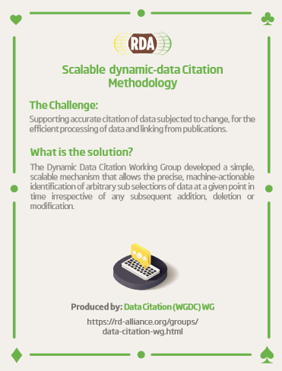
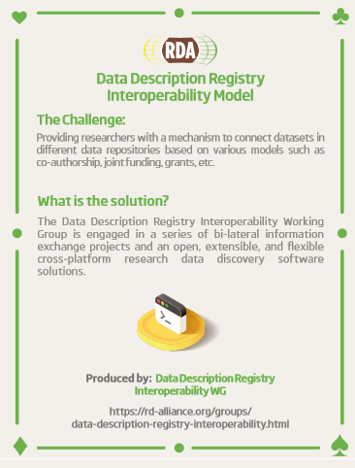
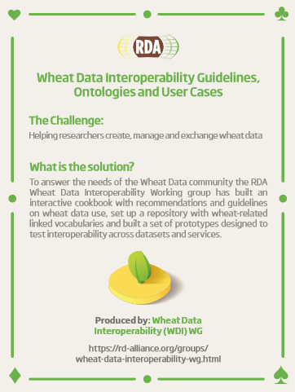
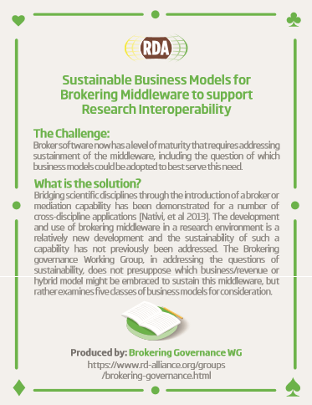
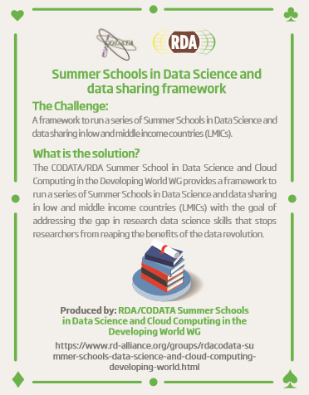
RDA Recommendations & Outputs
Data Citation: defining mechanisms to reliably cite dynamic data
Data Description Registry Interoperability solutions enabling cross platform discovery based on existing open protocols and standards
Wheat Data Interoperability impacting the discoverability, reusability and interoperability of wheat data by building a common framework for describing, representing linking and publishing wheat data
Brokering Governance WG: Sustainable Business Models for Brokering Middleware to support Research Interoperability
RDA/CODATA Summer Schools in Data Science and Cloud Computing in the Developing World WG: A framework to run a series of Summer Schools in Data Science and data sharing in low and middle income countries (LMICs)
rd-alliance.org/recommendations-and-outputs/all-recommendations-and-outputs
CC BY-SA 4.0

Slide 19
RDA Recommendations & Outputs
Repository Audit and Certification DSA–WDS: A convergent DSA-WDS certification standard to help eliminate duplication of effort, increase certification procedure coherence and compatibility thus benefitting researchers, data managers, librarians and scientific communities.
RDA/WDS Publishing Data Bibliometrics: improved research data metrics and corresponding services, with the final goal of increasing the overall availability and quality of citations and research data itself.
RDA/WDS Publishing Data Workflows: enhance the possibilities for greater discoverability and a more efficient and reliable reuse of research data benefitting other stakeholders like publishers, libraries and data centres.
RDA/WDS Publishing Data Services: A universal interlinking service between data and the scientific literature. The Scholix initiative a high level interoperability framework for exchanging information about the links between scholarly literature and data. It aims to build an open information ecosystem to understand systematically what data underpins literature and what literature references data.
rd-alliance.org/recommendations-and-outputs/all-recommendations-and-outputs
rd-alliance.org/recommendations-and-outputs/all-recommendations-and-outputs
CC BY-SA 4.0

Slide 20
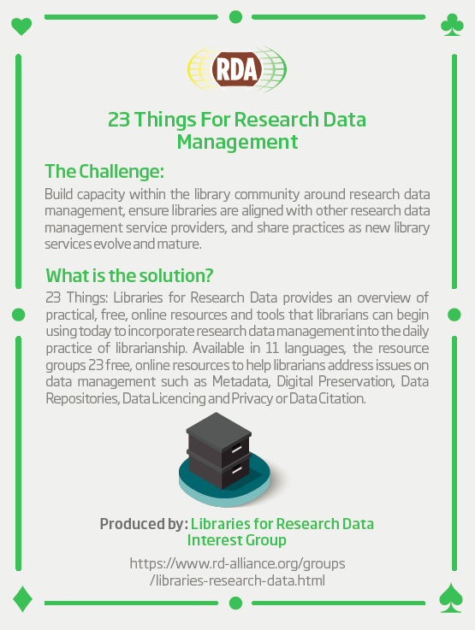
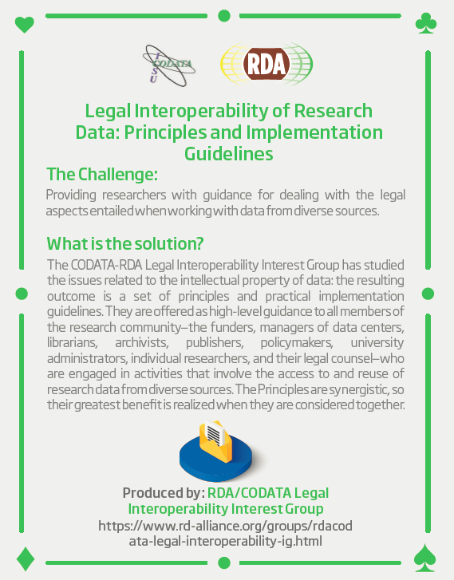
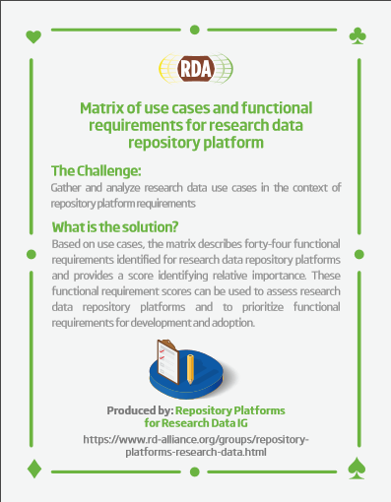
RDA Recommendations & Outputs
23 Things: Libraries For Research Data An overview of practical, free, online resources and tools that users can immediately take advantage of to incorporate research data management into the practice of librarianship.
Legal Interoperability of Research Data Principles and Implementation Guidelines: a set of principles and practical implementation guidelines offered as high-level guidance to all members of the research community —the funders, managers of data centers, librarians, archivists, publishers, policymakers, university administrators, individual researchers, and their legal counsel.
Matrix of use cases and functional requirements for research data repository platform Based on use cases, the matrix describes forty-four functional requirements identified for research data repository platforms and provides a score identifying relative importance.
BioSharing Recommendations Data repositories, standards and policies in the life, biomedical and environmental sciences
rd-alliance.org/recommendations-and-outputs/all-recommendations-and-outputs
rd-alliance.org/recommendations-and-outputs/all-recommendations-and-outputs
CC BY-SA 4.0

Slide 21
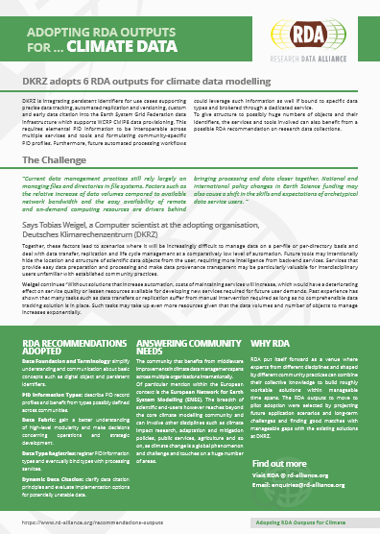
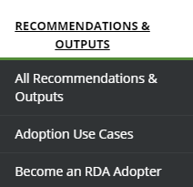
Adoption & Implementation “Solving the problem must include adopters in the process, to ensure that real problems are addressed. Open problem solving is the key.”
RDA Recommendations and Outputs take the form of technical specifications, code, policies or practices, harmonized standards or reference models. In the widest sense these aim for:
Greater data sharing, exchange, interoperability, usability and re-usability;
Greater discoverability of research data sets;
Better management, stewardship, and preservation of research data;
New data standards or harmonization of existing standards.
RDA Adoption & Implementation Stories - Tell us yours!
Addressing data challenges
https://www.rd-alliance.org/recommendations-and-outputs/all-recommendations-and-outputs
75 Adoption Cases
https://www.rd-alliance.org/recommendations-outputs/adoption-recommendations
Find out how you can become an Adopter
https://www.rd-alliance.org/recommendations-and-outcomes/become-rda-adopter
rd-alliance.org/recommendations-and-outputs/all-recommendations-and-outputs
CC BY-SA 4.0

Slide 22
Call for Supporting and Other RDA Outputs
If your group has produced something that you would like to share with the broader community, please send it to enquiries@rd-alliance.org and indicate whether you would like it to be considered as a ‘Supporting’ or ‘Other’ output.
https://rd-alliance.org/call-supporting-and-other-rda-outputs
rd-alliance.org/call-supporting-and-other-rda-outputs
CC BY-SA 4.0

Slide 23
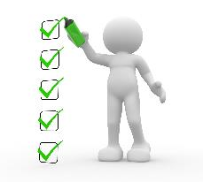
What are Plenary Meetings?
Organised around the world every 6 months
exciting & productive events bringing together a unique community of data science professionals, from multiple disciplines and domains;
help move the community forward in creating tangible deliverables that improve data sharing across disciplines, technologies, and countries;
heart of the plenaries are working meetings of RDA Working & Interest groups and new potential groups through Birds of a Feather meetings
presentation of new Outputs and Adoption cases
rd-alliance.org/plenaries
CC BY-SA 4.0

Slide 24
RDA Plenary Meetings: benefits of attending
Exchange knowledge, share discoveries, discuss barriers and potential solutions
Learn about new trends, strategies, research developments, directions and policies
Expand your network and meet new committed and passionate data science professionals, working in multiple disciplines
Contribute to acceleration of data infrastructure development
rd-alliance.org/plenaries
CC BY-SA 4.0
Notes:
Expand your network and meet new data science professionals, working in multiple disciplines, including but not limited to academia, library sciences, earth science, astronomy and meteorology

Slide 25
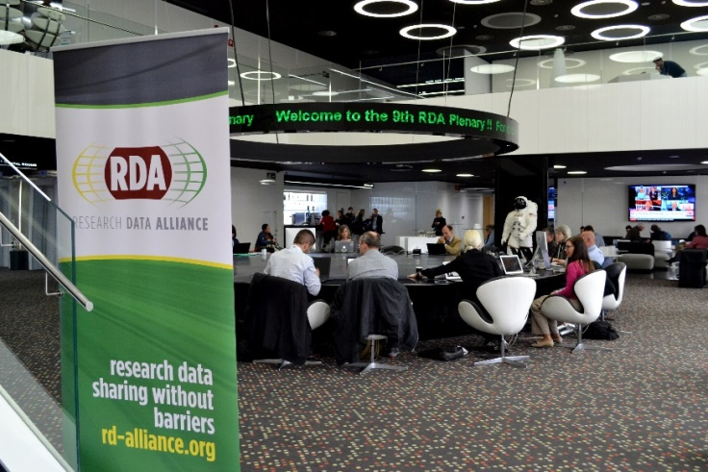
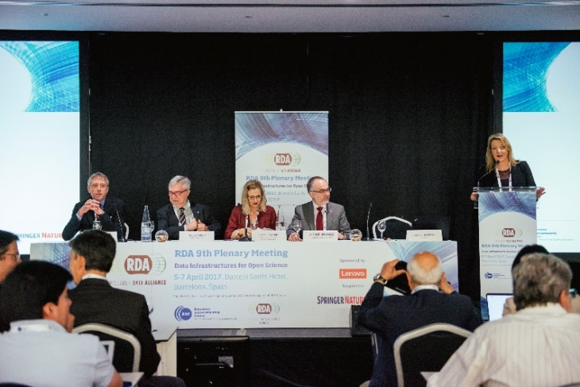
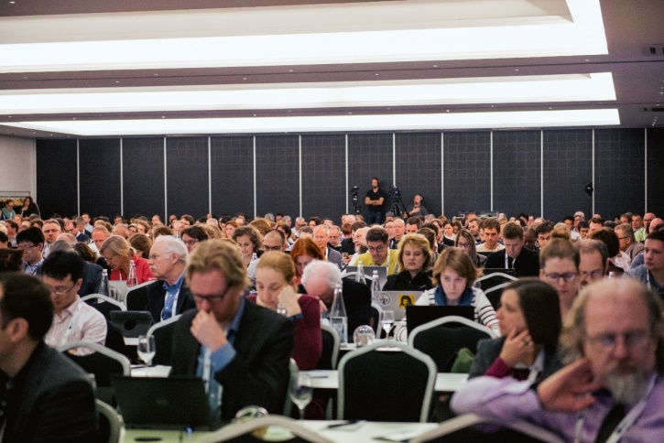
73 Breakout meetings
of which 15 Working Groups
of which 32 Interest Groups
of which 13 Joint Working & Interest Groups
of which 13 Birds of a Feather
3 Outputs presented
54 Posters
620 participants from 45 countries
rd-alliance.org/plenaries/rda-ninth-plenary-meeting-barcelona
CC BY-SA 4.0

Slide 26
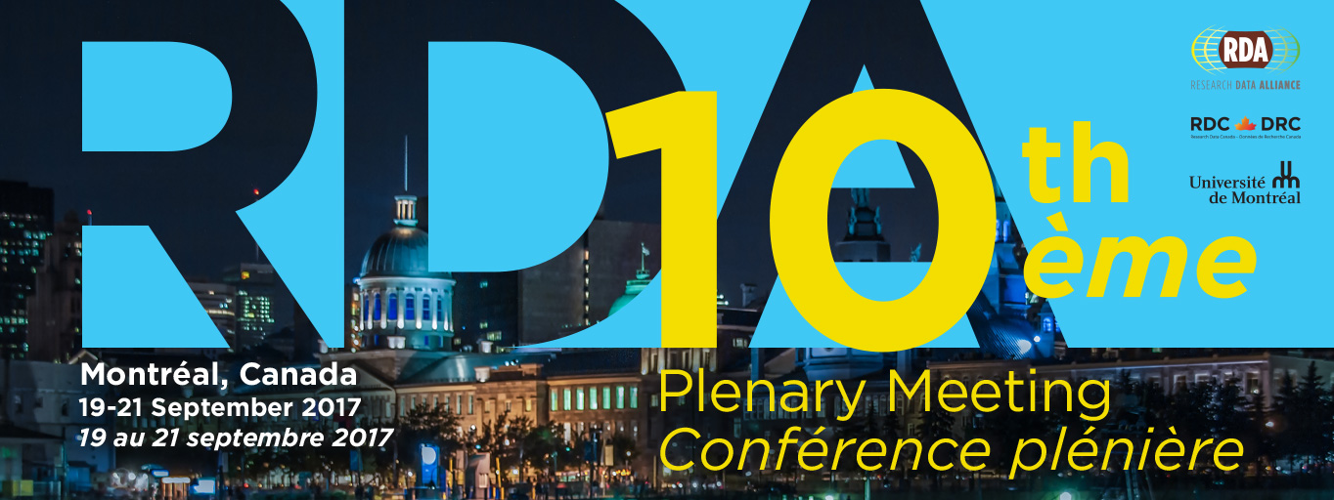
Register now:
https://www.rd-alliance.org/rda-10th-plenary-registration
Early Bird registration ends August 14, 2017 midnight EDT
https://www.rd-alliance.org/plenaries/rda-tenth-plenary-meeting-montréal-canada
Call for sessions https://www.rd-alliance.org/rda-10th-plenary-call-sessions - ends 23 June 17:00 UTC
Call for Collocated & Associated Events
https://www.rd-alliance.org/rda-10th-plenary-collocated-associated-events - ends 20 June 17:00 UTC
Call for Poster Session https://www.rd-alliance.org/rda-10th-plenary-poster-session - ends 25 July midnight UTC
Joining our sponsorship program https://www.rd-alliance.org/rda-10th-plenary-sponsorship-opportunities
rd-alliance.org/plenaries/rda-tenth-plenary-meeting-montreal-canada
CC BY-SA 4.0

Slide 27
Wondering about future Plenaries?
The 11th Plenary meeting will take place in March 2018 in Berlin, Germany
The 12th Plenary meeting will be co-organised within the framework of International Data Week (Sept / Oct 2018) with CODATA & WDS
rd-alliance.org/plenaries
CC BY-SA 4.0

Slide 28
RDA News
Updates – Future plans
Migrating to new Secretary General
Next RDA Europe project will focus more at national/regional level
Check out national/regional pages: https://www.rd-alliance.org/groups/rda-south-eastern-europe
Sustainability plans – RDA Task Force on Sustainability
RDA Atlas of Knowledge (beta): Capturing and integrating RDA outputs: http://core.cloud.dcu.gr/rda_aok/
rd-alliance.org/recommendations-outputs
CC BY-SA 4.0
Notes:
What are the outputs: ranging from best practices, specifications and policies to data models, APIs and snippets of code/ prototype implementations
WGs: up to 18 months have to deliver outputs; IGs do not have to produce outputs

Slide 29
RDA in a Nutshell www.rd-alliance.org/ @resdatall
RDA Global
Email - enquiries@rd-alliance.org
Web - www.rd-alliance.org
Twitter - @resdatall
LinkedIn - www.linkedin.com/in/ResearchDataAlliance
Slideshare - http://www.slideshare.net/ResearchDataAlliance
RDA Europe
Email - info@europe.rd-alliance.org
Twitter - @RDA_Europe
RDA US
Twitter - @RDA_US

